Slide 1
PROJECT TITTLE
GENERATIVE AI IN DRUG DISCOVERY
Presented By:
Raj Priya. M
613521104033

Slide 2
AGENDA
1.Problem Statement
2.Project Overview
3.End Users
4.Our Solution and Proposition
5.Key Features
6.Modelling Approach
7.Results and Evaluation
8.Conclusion

Slide 3
PROBLEM STATEMENT
1.Develop a generative AI model for drug discovery and identify a key challenges in drug discovery
2. Address challenges: high costs, low success rates, and data limitations.
3. Ensure interpretability of results for trust and regulatory compliance.
4. Navigate ethical considerations surrounding data privacy and patient consent.
5. Revolutionize pharmaceutical research by accelerating drug identification and development.
6.Discuss how AI can address these challenges and improve efiiciency in the drug deployment pipeline.

Slide 4
PROJECT OVERVIEW
Clearly defined goals of the project , such as:
  Developing AI algorithms for predictive modeling of drug-target interactions.
  Integrating diverse data sources( genomic, proteomic, chemical, clinical)for comprehensive analysis.
  Ensuring reproductivity and validation of AI-generated findings.
  Addressing ethical and regulatory considerations in AI-driven drug discovery.
  Accelerated Discovery , Cost Reduction , Rare Disease Focus , Ethical Concerns.

Slide 5
WHO ARE THE END USERS?
Here some examples of end users who benefit from the application of generative AI in drug discovery:
  Patients(improve treatments)
  Healthcare providers(broader treatment options)
  Pharmaceutical companies(cost and time savings)
  Researches(new discoveries)
  Regulatory agencies(informed decisions)
  Investors(potential returns)

Slide 6
SOLUTION AND ITS VALUE PROPOSITION
Solution:
  Generative AI Drug Discovery Platform
Value Proposition:
  Our platform accelerates drug discovery , reduces costs ,
  fosters innovation , tailors treatments , addresses rare diseases,
  enables personalized medicine , ensures regulatory compliance ,
  and continuously improves outcomes

Slide 7
THE WOW IN YOUR SOLUTION
Molecular Generation : AI designs new chemical structures.
Property Prediction : Algorithms forecast molecular properties like potency and toxicity.
Optimization : AI refines molecules for desired biological activities.
Virtual Screening: AI sifts through compound libraries for potential drug candidates.
De Novo Design: AI creates molecules from scratch.
Generative Models: Deep learning architectures generate diverse molecular structures.
Speed and Efficiency: AI speeds up the discovery process by exploring chemical space rapidly.

Slide 8
MODELING
Here the modeling approach using Generative Adversarial Network (GANs), Variational Autoencoders (VAEs) .
Encoders:
  Converts molecular structures into a latent space representation.
Decoder:
  Reconstructs molecular structures from the latent space.
Training:
  Trained on known molecular structures to learn encoding and decoding.
Sampling:
  Generates new molecules by sampling points from the latent space.
Property Prediction:
  Evaluates generated molecules for desired properties.

Slide 9
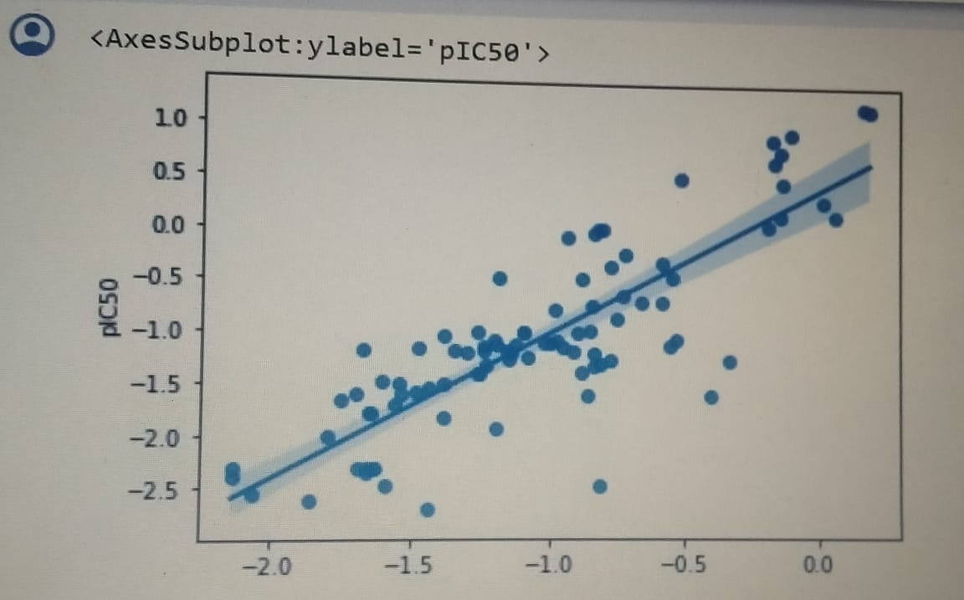
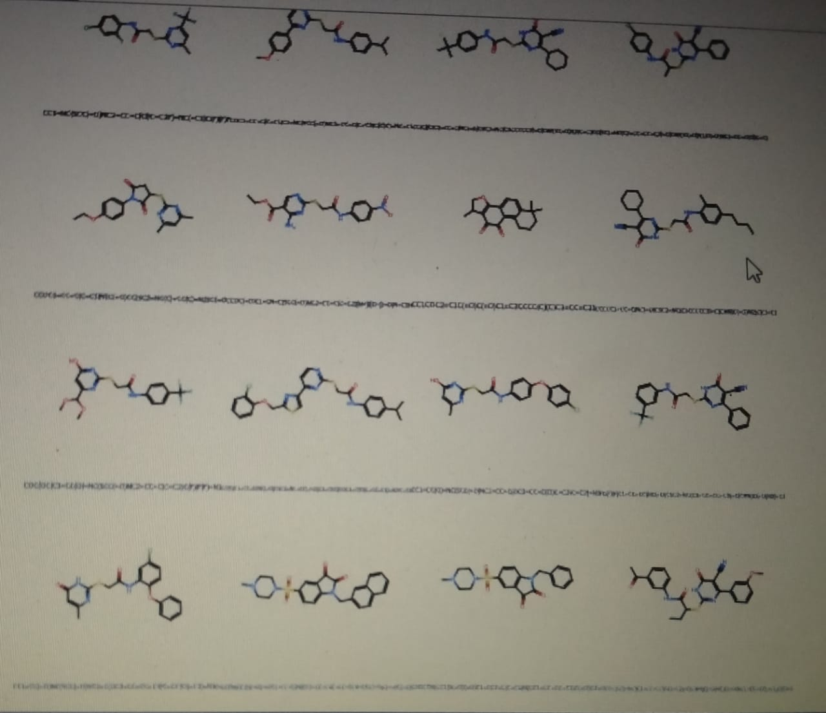
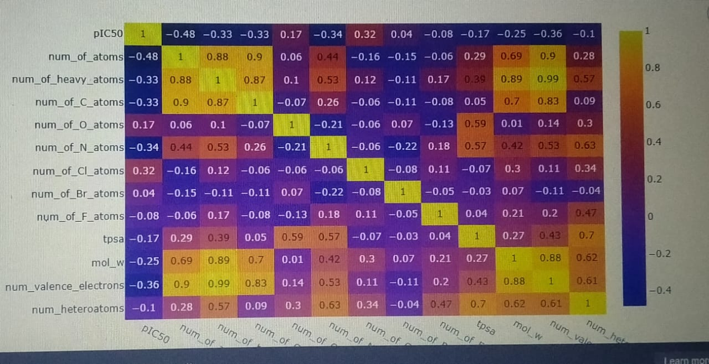
RESULTS

